Slide 1
IG policies for sharing data

Slide 2
The Caldicott Review stated “The duty to share information can be just as important as the duty to protect patient confidentiality.” This emphasises the importance of sharing data between professionals across organisations, it can result in better integration of services and an overall improved patient service.
In order to share information in a regulated way, employees are supported with principles and policies regarding Information Governance and data sharing. Data protection regulations, particularly the General Data Protection Regulation (GDPR) and Data Protection Act (DPA) have had a significant impact on the practical implementation of data protection measures in the NHS. All employees must comply with these legislations.

Slide 3
Data Protection Act 1998
To ensure GDPR compliance within the NHS, NHS digital released a Strategic Approach document which outlines key steps organisations should be taking. The 4 key points include:
Discovery:
Identify all information assets/ systems
Assess current DPA 1998 compliance across organisation
Transition:
Appointment of a DPA officer
Implement changes to local working practices to meet GDPR compliance
Education:
GDPR awareness mandatory training to be completed by all staff + reviewed annually
Assurance:
Audit programmes in place

Slide 4
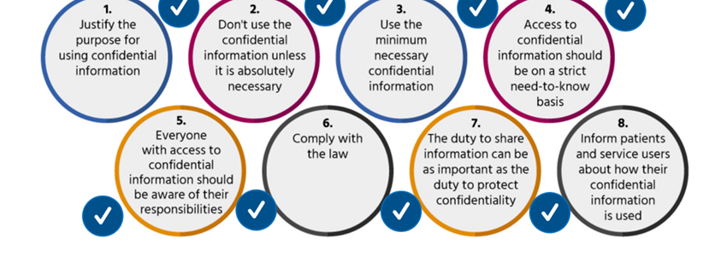
Caldicott Principles

Slide 5
Checklist
When deciding to share or receive personal data, the most important factor to consider is what is the sharing meant to achieve? A lawful basis should be identified for processing data.
What is being shared? Only relevant information should be shared. The third Caldicott principle specifies “Use the minimum necessary personal confidential data.“
Can the result be achieved through anonymised sharing?
When will it be shared? Will this be ‘systematic’ routine sharing where the same data sets are shared between the same organisations for an established purpose or ‘one-off’.
How will it be shared? Identifying and addressing the risks around the accessing/ transmission of information and establishing plans to mitigate risks and prioritise security.
National data opt-out programme? If a patient has opted out, data must not be shared.

